Slide 1
Evolutionary Mechanisms

Slide 2
Gene pools
Population- group of the same organisms of the same species living together in a particular place at a particular time
Gene pool – sum of all alleles in a population
Allele frequency – how often an allele occurs in a gene pool
Allele frequency for the alleles for blue eyes in a Scandinavian population is greater than that of an African population. Vice versa for brown eyes.

Slide 3
Changes to allele frequencies
Mutations
Variations in offspring which are not found in the parents. Can occur quite suddenly or by chance.
Gene mutation – changes in DNA of a single gene
Chromosomal mutations – where part or all of a chromosome is affected
Somatic mutation – mutation in body cells
Germline mutation – mutation in gametes

Slide 4
Natural Selection
Natural selection – when the environment favours an organism's phenotype, or observable features.
In large populations, the proportion of alleles for each generation is much the same
However, if a selection pressure induces natural selection, then over time these proportions will change
Not random

Slide 5
Random Genetic Drift
Random genetic drift - Small populations often have random variation in allele frequencies
Founder effect
Small group moves to a new area and establishes a community which expands
Migrant population unlikely to be genetically representative of original population
Show traits which are not typical of original population

Slide 6
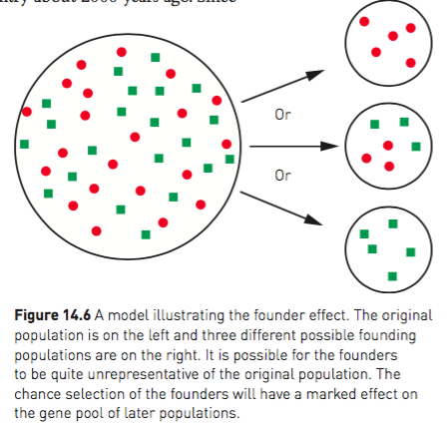
Founder Effect

Slide 7
Migration
Migration – gene flow from one population to another
If immigrants bring alleles that are not already in the population, then the allele frequencies for that gene will be altered
Eg: China’s population all had Rh+ blood. Europeans migrated to China, bringing Rh- allele to the country and changing the allele frequencies for Rhesus factor

Slide 8
Barriers to gene flow
Populations often kept apart by barriers that inhibit interbreeding between them
Different environments mean different selection pressures, resulting in different alleles being favoured and therefore different allele frequencies
Geographical barriers: oceans, mountains, deserts
Sociocultural barriers: economic status, religion, social position, educational background

Slide 9
Genetic diseases
Genetic disease leads to changes in allele frequency – an allele causing a fatal disease would be expected to be gradually eliminated

Slide 10
Tay-Sachs disease (TSD) – hereditary disorder of lipid metabolism, occurs most frequently in Ashkenazi Jewish people. Death usually occurs by 4-5 years old.
Worldwide frequency is 1:500 000. In Jewish populations 1:2 500
Thought to be caused by a combination of natural selection and random genetic drift
Due to discrimination, Ashkenazi Jews found themselves in overcrowded ghettos, increasing chance of TB
Heterozygous individuals are resistant to Tuberculosis (TB).
Notes:
Jewish populations – small and isolated

Slide 11
Evolution through natural selection
Evolution – gradual change in the characteristics of a species
Charles Darwin created the theory of natural selection

Slide 12
Natural Selection
Based on 3 observations:
Variation: Members of a species vary and these variations are passed on to offspring
Birth rate: Living organisms reproduce at a far greater rate than that at which their food and resource supply will support. Results in overcrowding
Nature’s balance: Although birth rate is high, each species maintained their numbers at relatively constant level

Slide 13
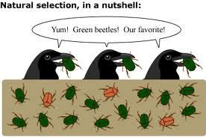
Darwin realised that:
There must have been a struggle for existence
Those with characteristics best suited to their environment are more likely to survive (survival of the fittest)
Survival of the fittest is possible because of variation in a species

Slide 14
Gradually over time, the characteristics of a population change so it becomes better suited to its environment.
Where environments are changing, characteristics that enhance survival will enable surviving generations to gradually adapt to it
Adaptations take many, many generations to develop
Natural selection and allele frequencies – If the environment favours a particular characteristic, then frequency for this alleles will increase, over time

Slide 15
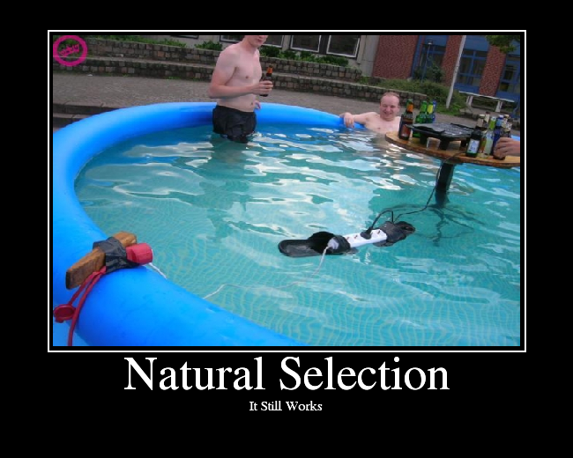

Slide 16
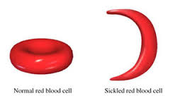
Natural Selection case-study: Sickle-cell anaemia
Sickle-cell anaemia– a disease that causes red-blood cells to have a sickle shape
Causes person to experience dizziness, shortness of breath, due to lack of oxygen
Disease is usually fatal in homozygote recessive individuals (ss)

Slide 17
The heterozygote (Ss) has some sickled cells and some normal RBC
Ss individuals are more resistant to malaria than homozygote normals (SS)
Malaria is said to be a selective agent for the sickle-cell allele

Slide 18
Speciation
Isolation is a barrier to gene flow. Reproductive isolation may lead to the development of separate gene pools
Different environments favour different alleles and allele frequencies change
Over many generations, the populations may become so great that even if the barriers to breeding were removed, interbreeding would no longer be possible

Slide 19
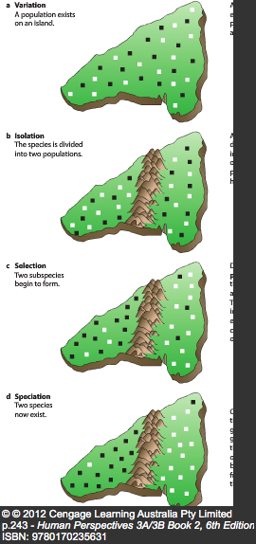
When this happens, speciation is said to have occurred – where 2 distinct species have arisen

